Slide 1
Digital Image Processing
Pattern Recognition

Slide 2
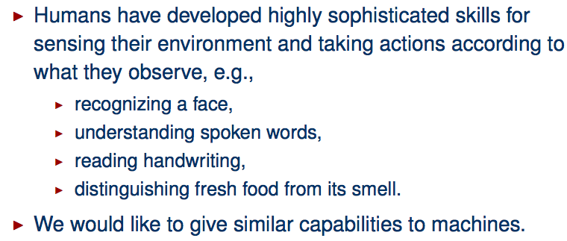
Human Perception

Slide 3
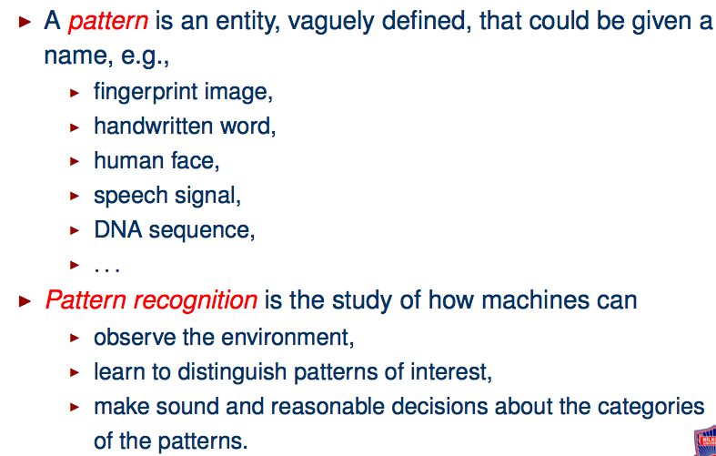
What is a Pattern Recognition?

Slide 4
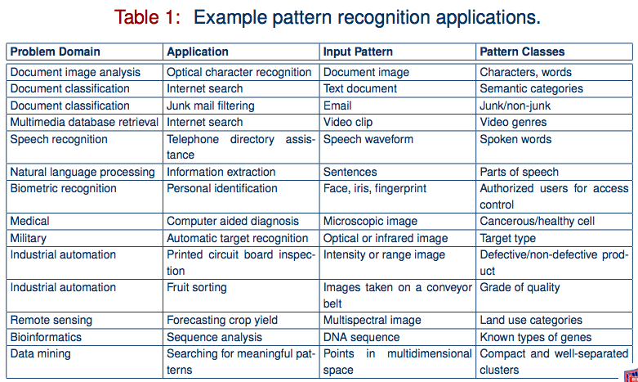
Pattern Recognition Applications

Slide 5
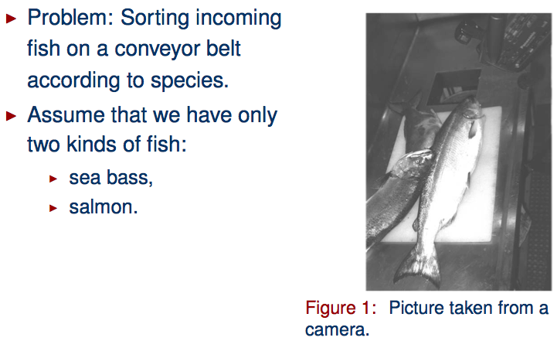
An Example

Slide 6
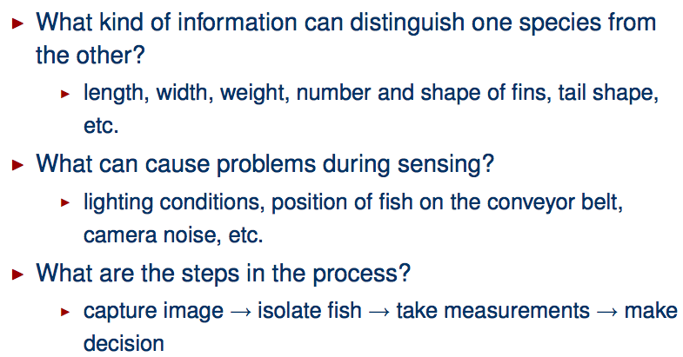
An Example : Decision Process

Slide 7
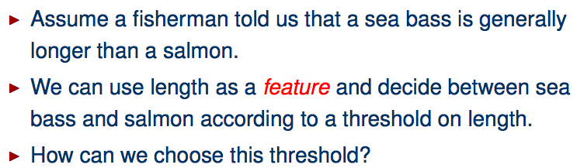
An Example : Selecting Features

Slide 8
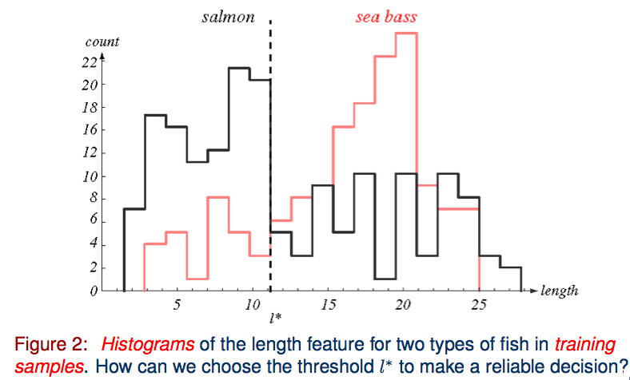
An Example : Selecting Features

Slide 9
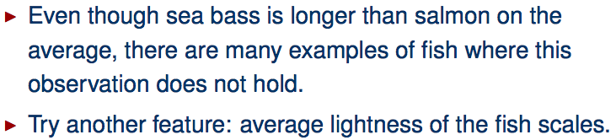
An Example : Selecting Features

Slide 10
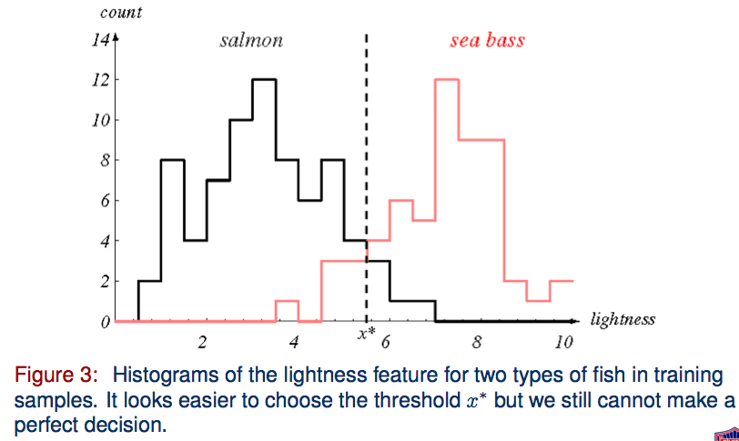
An Example : Selecting Features

Slide 11
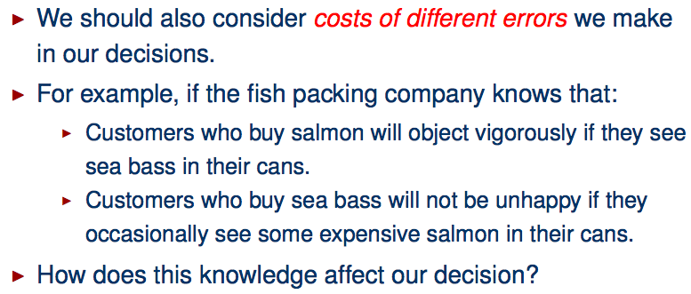
An Example : Cost of Error

Slide 12
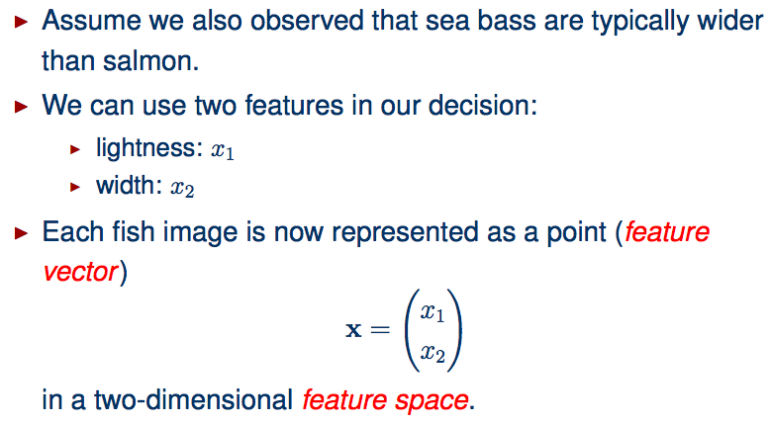
An Example : Cost of Error

Slide 13
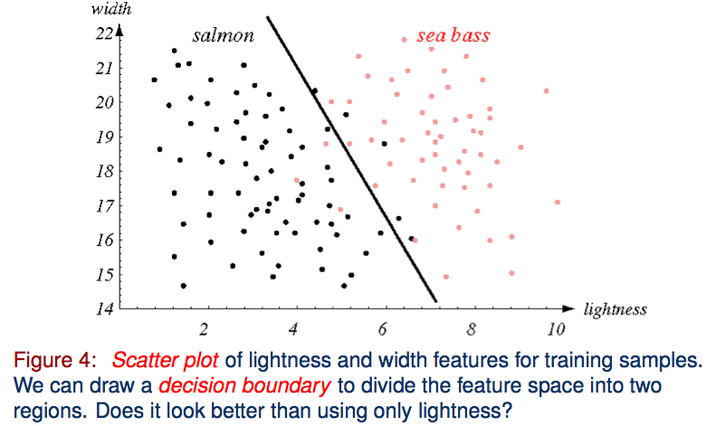
An Example : Multiple Features

Slide 14
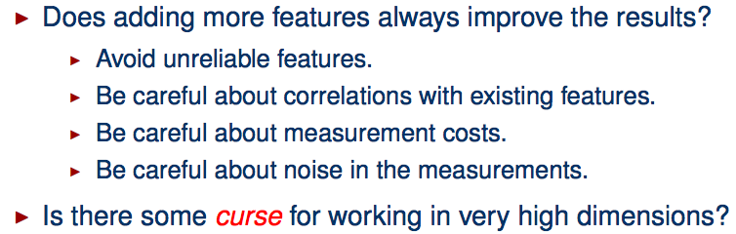
An Example : Multiple Features

Slide 15
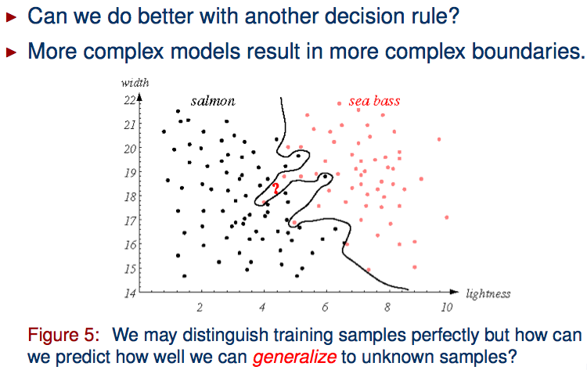
An Example : Decision Boundaries

Slide 16
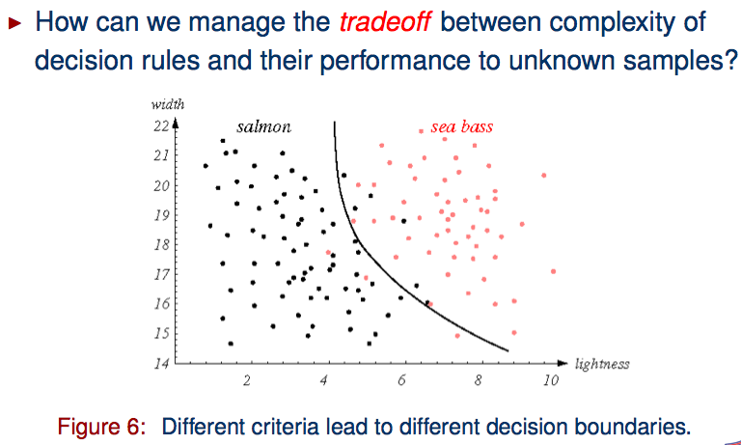
An Example : Decision Boundaries

Slide 17
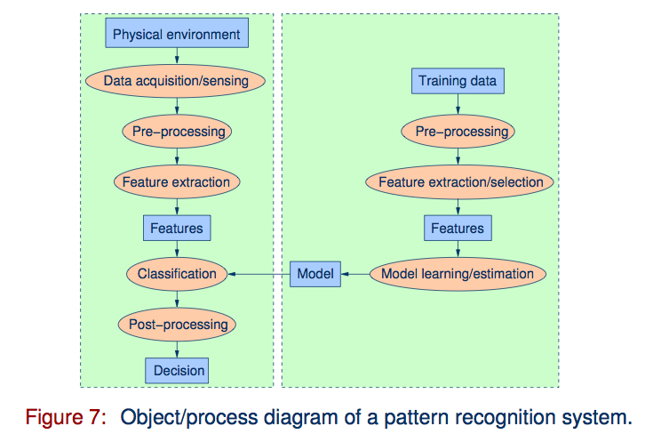
Pattern Recognition Systems

Slide 18
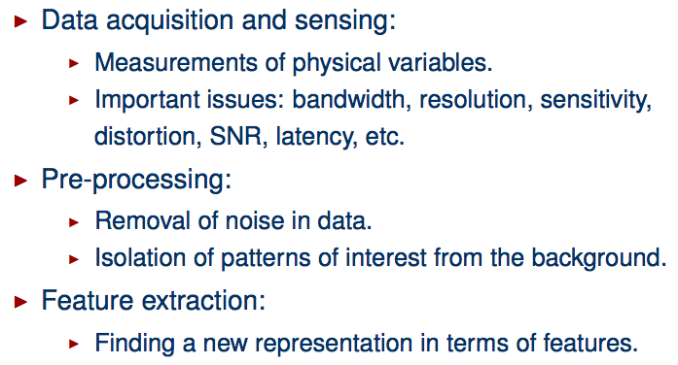
Pattern Recognition Systems

Slide 19
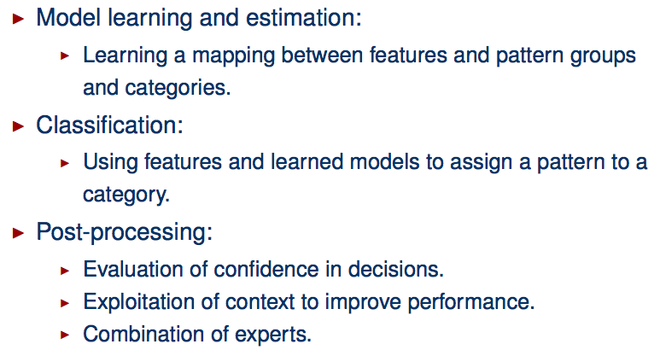
Pattern Recognition Systems

Slide 20
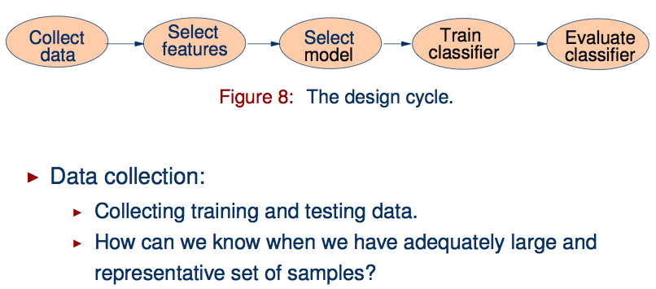
The Design Cycle

Slide 21
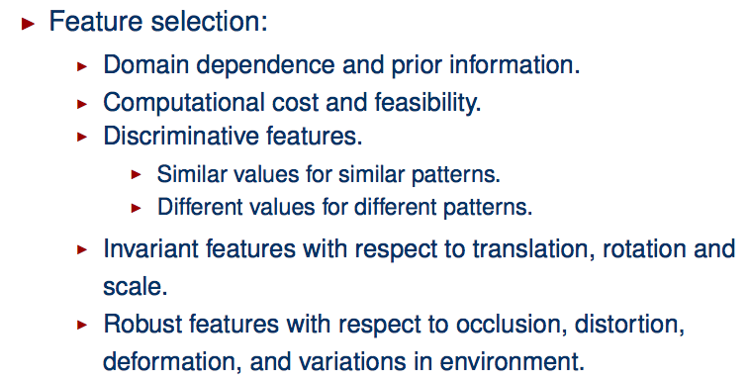
The Design Cycle

Slide 22
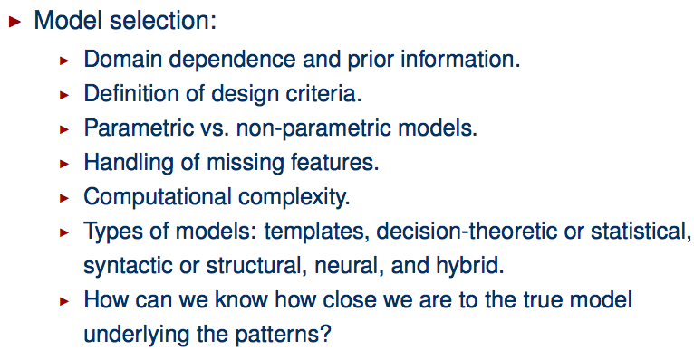
The Design Cycle

Slide 23
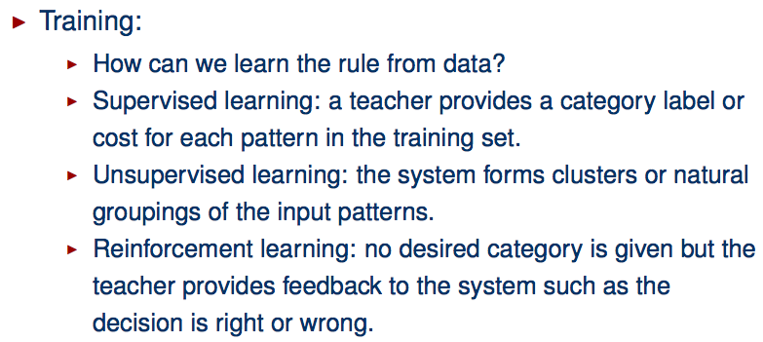
The Design Cycle

Slide 24
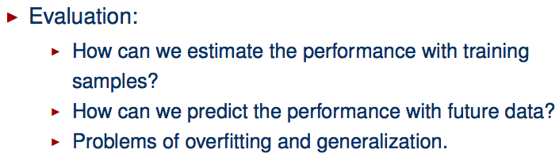
The Design Cycle

Slide 25
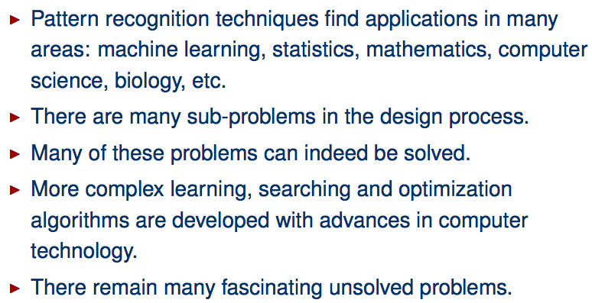
Summary

